Slide 1
Introduction to Deep Learning

Slide 2
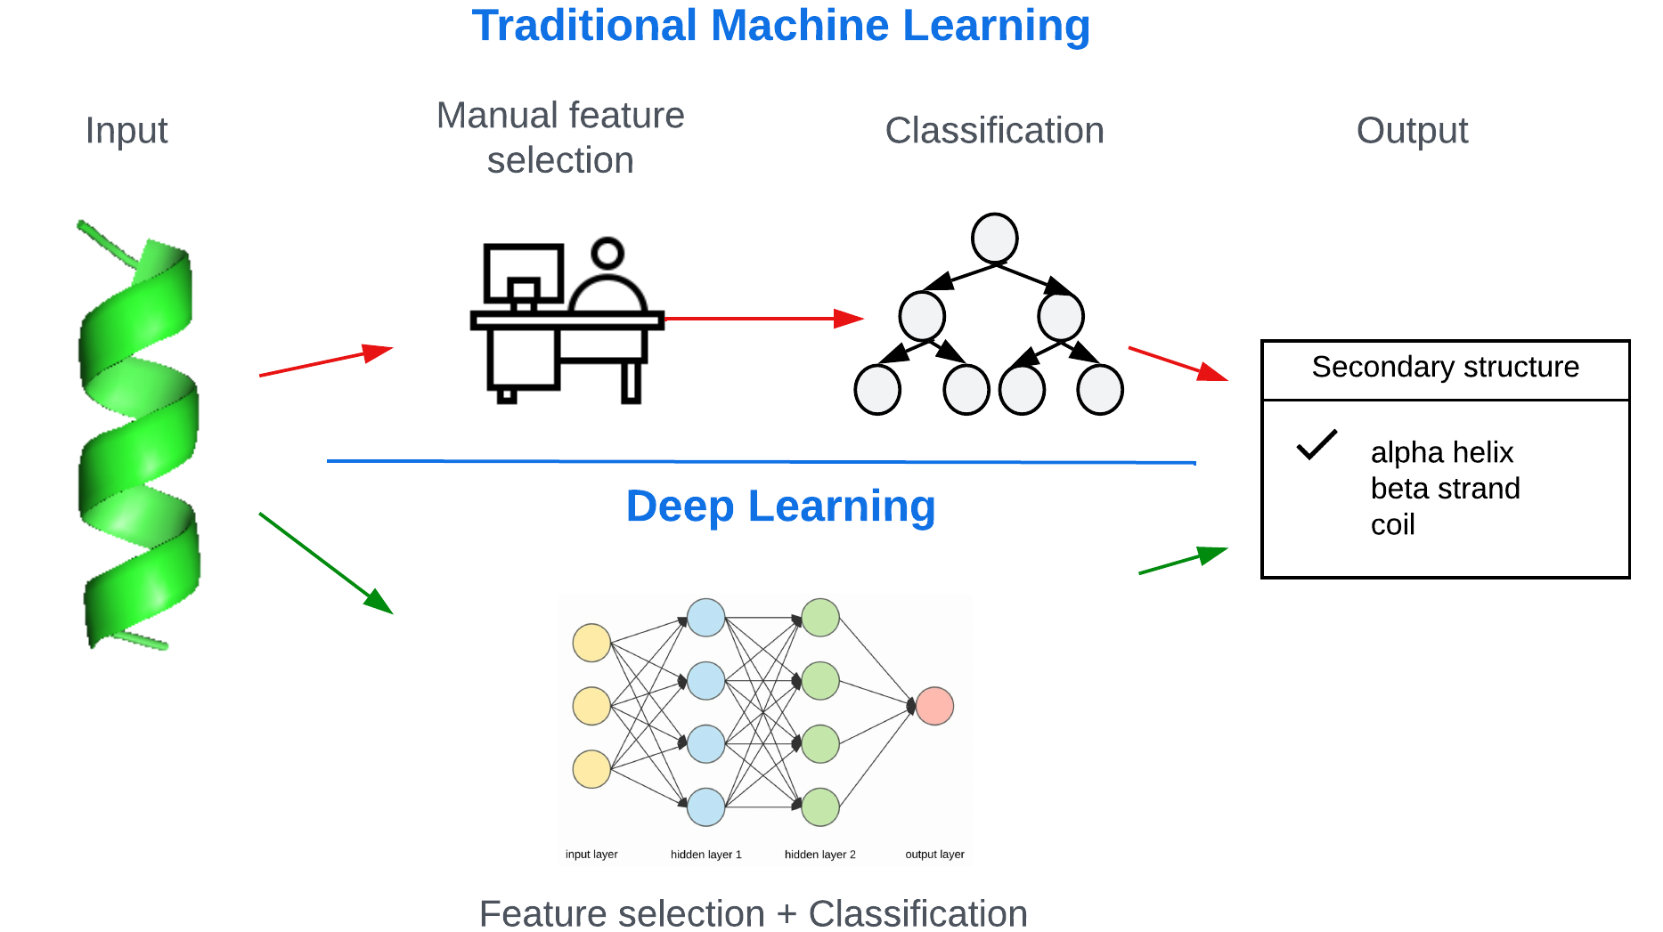
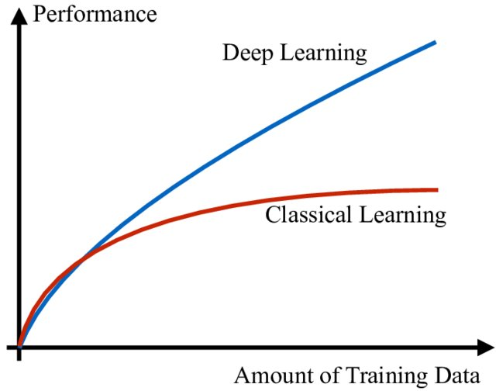
What is Deep Learning (DL)?
Created in LucidChart by C. Arighi
Source: Zappone, 2019

Slide 3
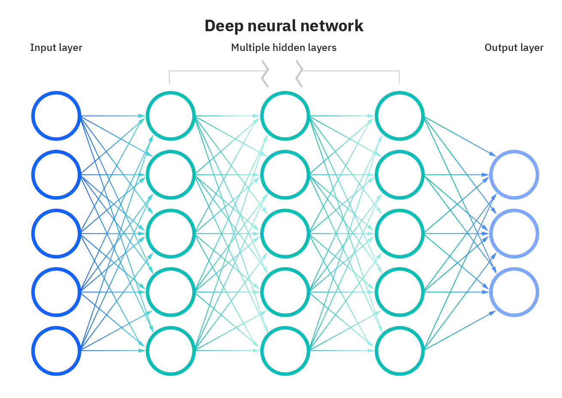
Artificial Neural Networks (ANNs)
Mimic the brain’s neurons
ANNs are made up of layers of nodes, weights, and activation functions.
The learning process involves adjusting these weights to minimize a loss function
source: https://www.ibm.com/cloud/learn/neural-networks

Slide 4
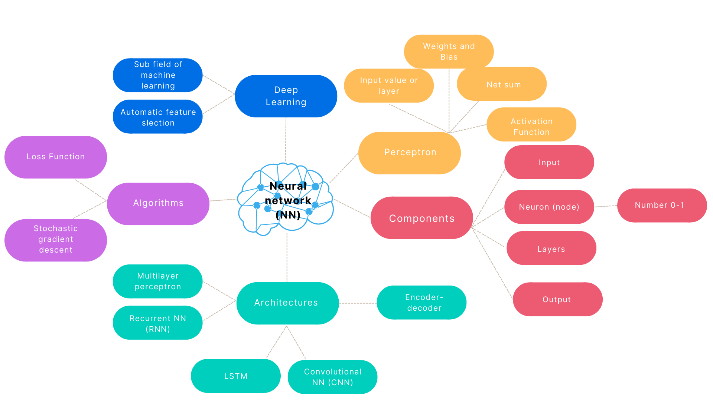

Slide 5
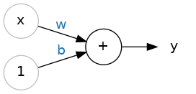
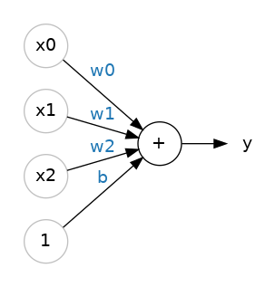
Single neuron
Input
Output
This neuron’s activation is linear function
y = wx + b.
W=weight, b=bias
If multiple input features the function results in
y = w₀x₀ + w₁x₁ + w₂x₂ + b
source: kaggle.com

Slide 6
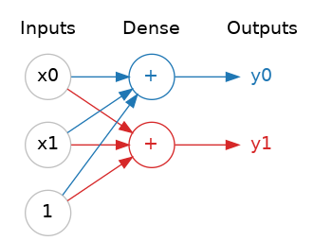
Layers
Layer
Neurons with same set of inputs form a layer.
Each layer in a neural network performs some kind of relatively simple transformation.
Layers can be stacked to model complex functions
source: kaggle.com
source: https://www.ibm.com/cloud/learn/neural-networks

Slide 7
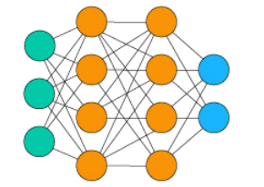
Two flows in neural network
Forward propagation
Input Layer
Output Layer
Backpropagation: weights updated to minimize error

Slide 9
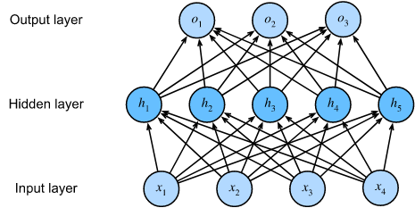
Multi-Layer Perceptrons (MLP)
A fully connected, feed-forward artificial neural network with at least three layers
source: d2l.ai

Slide 10

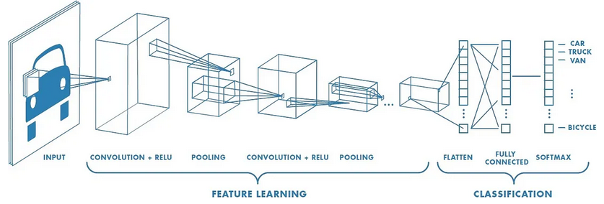
Convolutional Neural Networks (CNN)
Multiple convolutional layers, designed for spatial data
Pooling layers
Fully connected MLPs.
source: analyticsindiamag.com
source: medium.com

Slide 11

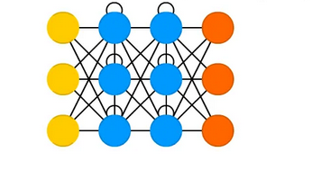
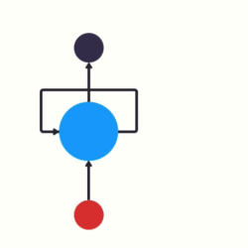
Recurrent Neural Networks (RNN)
Well-suited for sequential data like sequences, time series or text
Looped architecture
source: Tch, 2017
source: towardsdatascience.com

Slide 12
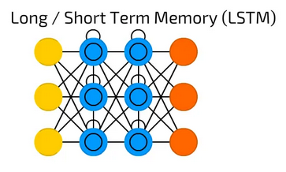
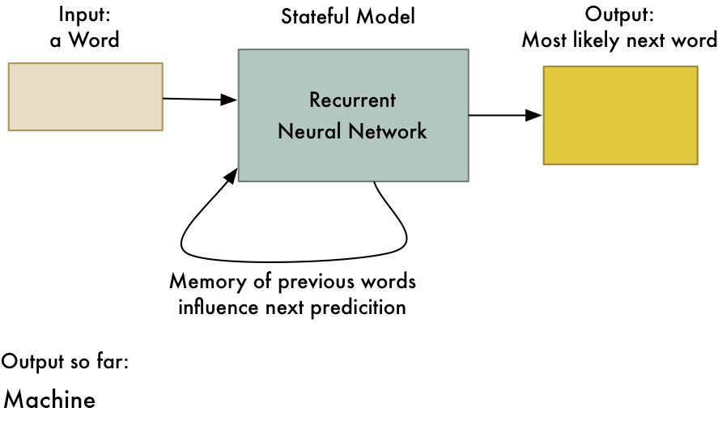
Long Short-Term Memory Networks (LSTMs)
Improved RNN with memory
source: Tch, 2017
source: Maladkar, 2018

Slide 13
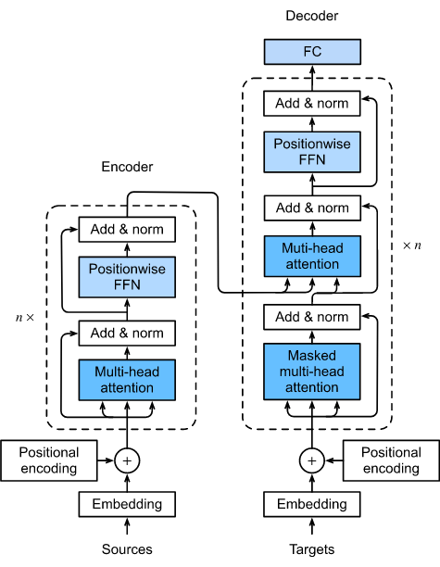
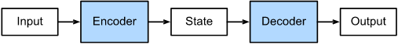
Encoder-Decoder Architecture
source: d2l.ai

Slide 14
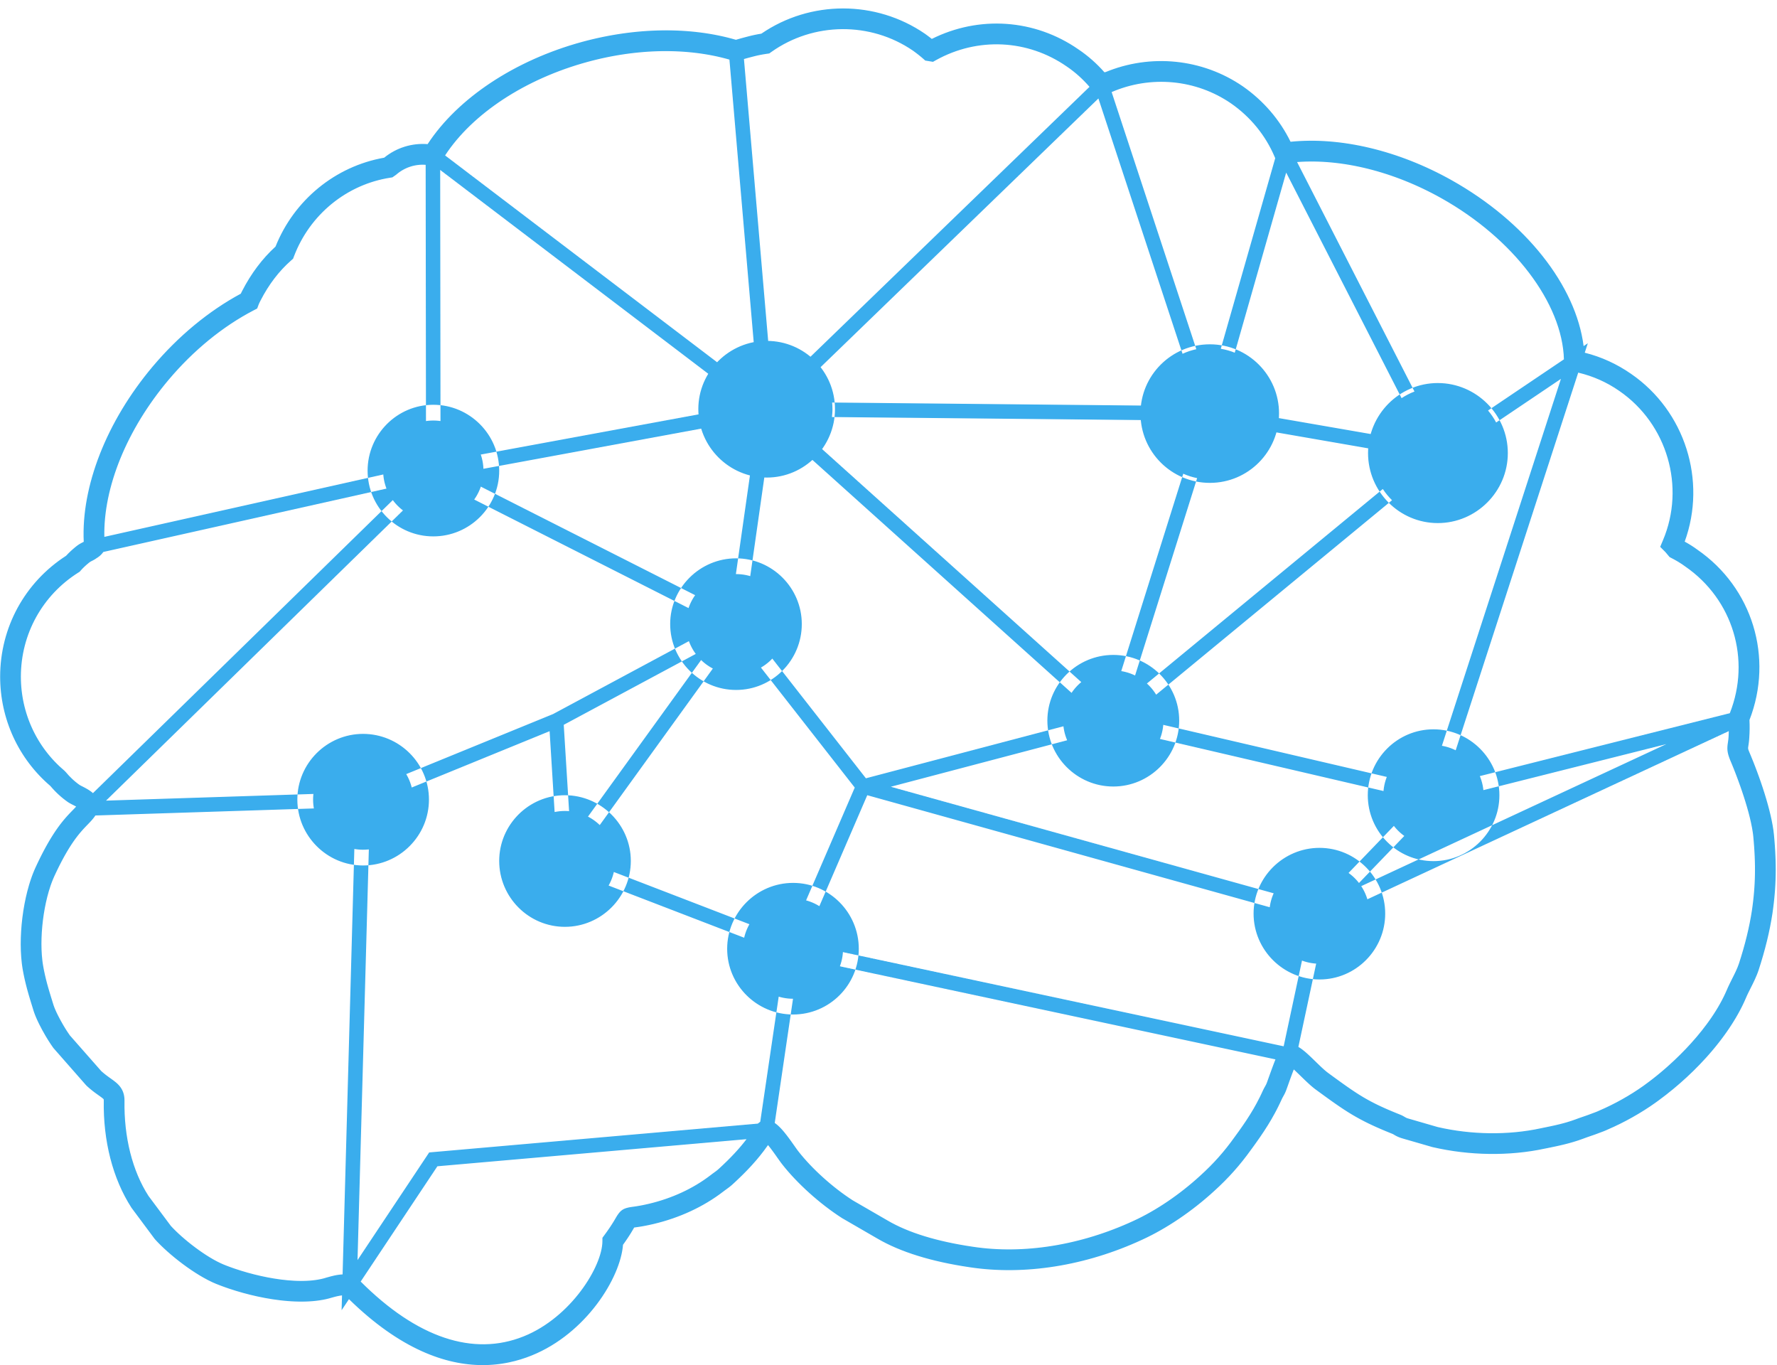
Neural network (NN)
Hyperparameters
Loss Function
Hyperparameters model architecture
Hyperparameters
training
Hyperparameters
regularization
Activation functions
Number of layers
Optimizer
Learning rate
Dropout rate
Number of epochs
Number neurons per layer
Batch size
Early Stopping criteria

Slide 15
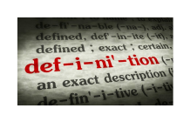

The activation function
An activation function is simply some function we apply to each of a layer's outputs (its activations) to introduce some non-linearity.
source: Jadon, 2018

Slide 16
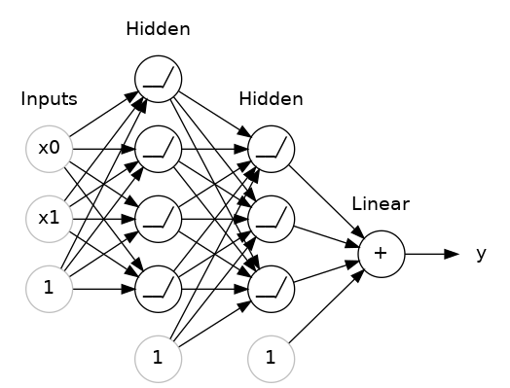
Stacking dense layers together
With some non-linearity, we can stack layers to get complex data transformations.
The final (output) layer is a linear unit (meaning, no activation function). That makes this network appropriate to a regression task, where we are trying to predict some arbitrary numeric value.
Other tasks (like classification) might require an activation function on the output.
source: kaggle.com

Slide 17
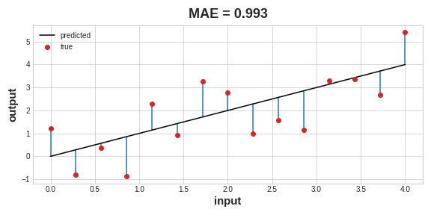
The loss function
Measures the disparity between the target's true value and the predicted value.
A common loss function for regression problems is the mean absolute error (MAE).
source: kaggle.com

Slide 18
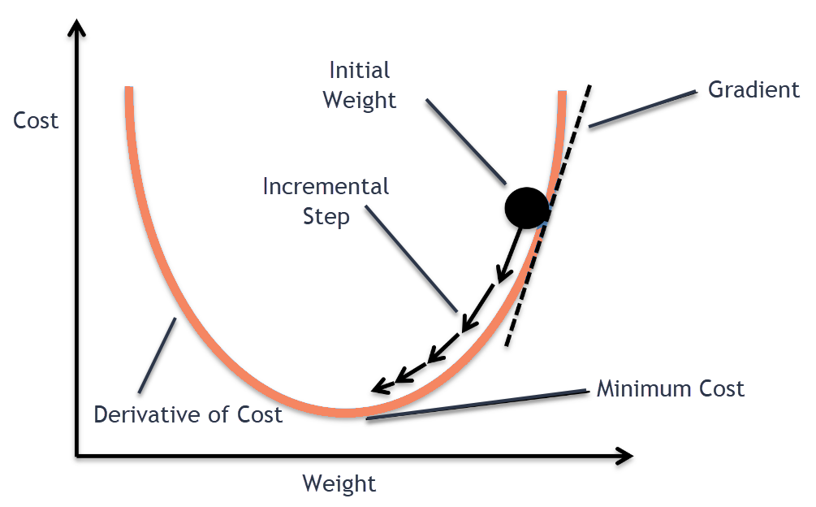
The optimizer: stochastic gradient descent
STEPS:
Sample some training data and run it through the network to make predictions
Measure the loss between the predictions and the true values
Adjust the weights toward lower loss
Repeat
https://medium.com/@divakar_239/stochastic-vs-batch-gradient-descent-8820568eada1

Slide 19
Learning Rate and Batch Size
Every time SGD sees a new minibatch, it will shift the weights (w the slope and b the y-intercept) toward their correct values on that batch.
The size of these shifts is determined by the learning rate. A smaller learning rate means the network needs to see more mini-batches before its weights converge to their best values.
The learning rate and the size of the mini-batches are the two parameters that have the largest effect on how the SGD training proceeds. Their interaction is often subtle and the right choice for these parameters isn't always obvious.
Adam is an SGD algorithm that has an adaptive learning rate that makes it suitable for most problems without any hyperparameter tuning.

Slide 20
The information in the training data
Signal:
The signal is the part that generalizes, the part that can help our model make predictions from new data.
Noise:
The noise is that part that is only true of the training data; the noise is all of the random fluctuation that comes from data in the real-world or all of the incidental, non-informative patterns that can't actually help the model make predictions. The noise is the part might look useful but really isn't.

Slide 21
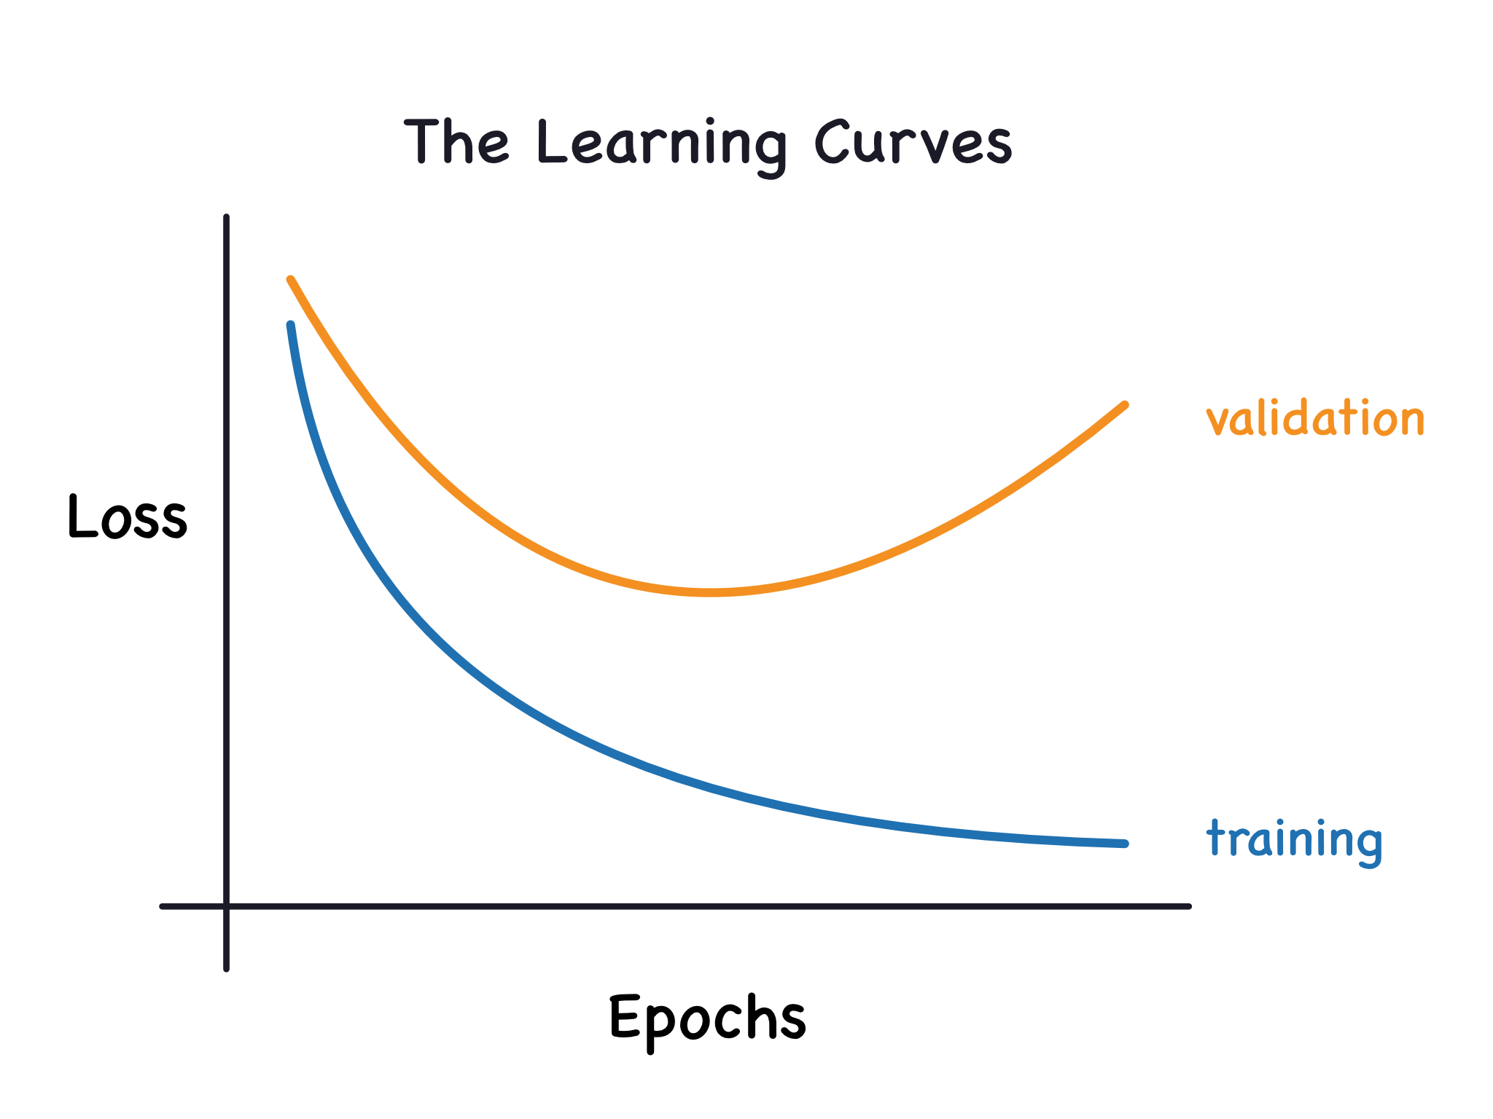
The learning curves
We train a model by choosing weights or parameters that minimize the loss on a training set. However, to accurately assess a model's performance, we also need to evaluate it on a new set of data, the validation data.
We can keep a history of the training and validation loss over the epochs during the model training process. That can be used to plot the learning curves.
The training loss will go down either when the model learns signal or when it learns noise. But the validation loss will go down only when the model learns signal.
When a model learns signal both curves go down, but when it learns noise a gap is created in the curves. The size of the gap tells you how much noise the model has learned.
source: kaggle.com

Slide 22
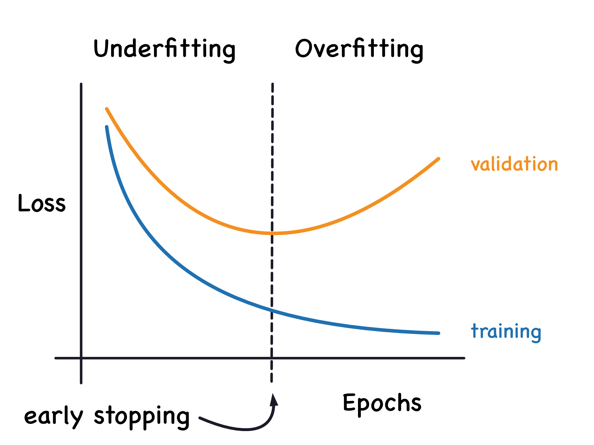
Early stopping
It is when we stop the training whenever it seems the validation loss isn't decreasing anymore.
source: kaggle.com

Slide 23
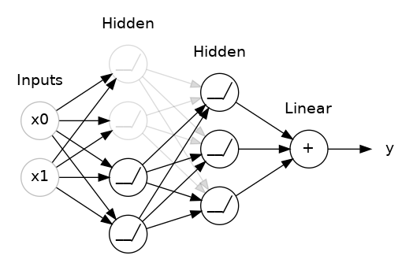
Dropout Layer
Overfitting is often caused by the network learning spurious patterns in the training data.
source: kaggle.com

Slide 24
Batch Normalization Layer
It is generally a good idea to put all of your data on a common scale.
A batch normalization layer looks at each batch as it comes in, first normalizing the batch with its own mean and standard deviation, and then putting the data on a new scale.
Batchnorm, in effect, performs a kind of coordinated rescaling of its inputs.

Slide 25
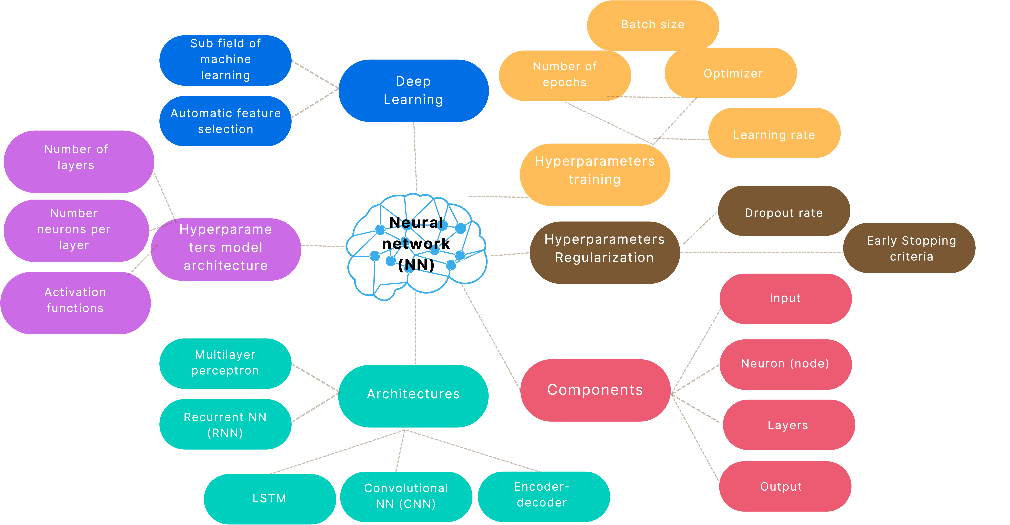
Deep Learning Mind Map
Created in Canva by C. Arighi

Slide 26

DeepChem
The DeepChem (deepchem.io) project aims to create high quality, open source tools for drug discovery, materials science, quantum chemistry, and biology.
The origin of DeepChem focused on applications of deep learning to chemistry, but the project has slowly evolved past its roots to broader applications of deep learning to the sciences in general
DeepChem is a machine learning library, so it gives you the tools to solve your applications. For example:
Predict the solubility of small drug-like molecules
Predict binding affinity for small molecule to protein targets
Predict physical properties of simple materials
Analyze protein structures and extract useful descriptors
Count the number of cells in a microscopy image

Slide 27

References
Dipanjan Sarkar, Raghav Bali and Tushar Sharma. 2018. Practical Machine Learning with Python. A Problem-Solver's Guide to Building Real-World Intelligent Systems. Apress. (https://doi.org/10.1007/978-1-4842-3207-1), Chapter 1
Divakar Kapil, 2019. Stochastic vs Batch Gradient Descent (https://medium.com/@divakar_239/stochastic-vs-batch-gradient-descent-8820568eada1)
TensorFlow tutorial. (https://www.tutorialspoint.com/tensorflow/tensorflow_multi_layer_perceptron_learning.htm)
Dive Into Deep Learning (https://d2l.ai/)
Kaggle course. Introduction to Deep Learning. (https://www.kaggle.com/learn/intro-to-deep-learning)
Shruti Jadon. Mar 15, 2018. Introduction to Different Activation Functions for Deep Learning. (https://medium.com/@shrutijadon10104776/survey-on-activation-functions-for-deep-learning-9689331ba092)
The DeepChem project (https://deepchem.readthedocs.io/en/latest/index.html)
Neural Networks (3Blue1Brown series)
Kishan Maladkar, 2018. 6 Types of Artificial Neural Networks in Machine Learning. analyticsindiamag.com/ai-trends/6-types-of-artificial-neural-networks-currently-being-used-in-todays-technology/
Amdrew Tch, August 4, 2017. The mostly complete chart of Neural Networks, explained. (https://medium.com/data-science/the-mostly-complete-chart-of-neural-networks-explained-3fb6f2367464)
Zappone, Alessio, Marco Di Renzo, and Mérouane Debbah. Wireless networks design in the era of deep learning: Model-based, AI-based, or both?. IEEE Transactions on Communications 67.10 (2019): 7331-7376.

